Slide 1



Test Design Techniques
Introduction
Mihail Parvanov
Team Lead
ASP.NET Team 2
Telerik QA Academy

Slide 2

Table of Contents
The Test Development Process
Categories of Test Design Techniques
Static Techniques
Reviews
Static Analysis
Dynamic Techniques
Specification-based (Black-box) Techniques
Choosing Test Techniques

Slide 3

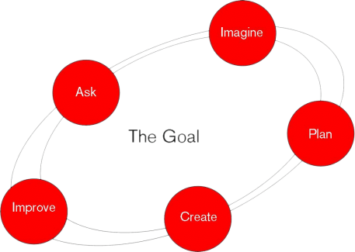
The Test Development Process
Some Basic Concepts

Slide 4
Level of Formality
Test development process can be performed with different level of formality
From strictly formalized to very informal - with little or no documentation
The level of formality depends on the context of the testing
Maturity of testing and development processes
Time constraints
Safety or regulatory requirements
People involved

Slide 5
Test Conditions
During test analysis, the test basis documentation is analyzed in order to determine what to test
To identify the test conditions
A test condition is an item or event that could be verified by one or more test cases
E.g., a function, transaction, quality characteristic or structural element

Slide 6
Test Cases
During test design the test cases and test data are created and specified
A test case consists of a set of elements:
Input values
Execution preconditions
Expected results
Execution postconditions
Test cases are developed to cover a certain test objective(s) or test condition(s)

Slide 7
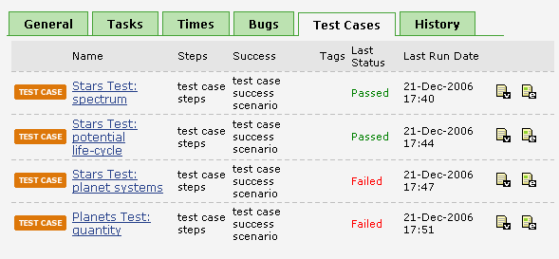
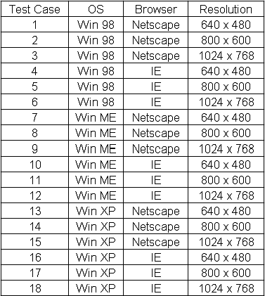
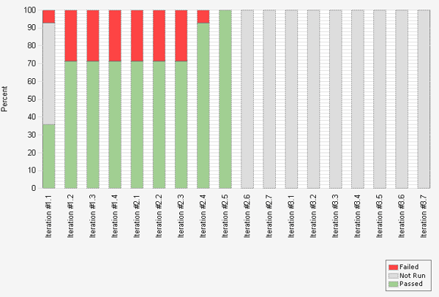
Test Case Examples
Quick Demo

Slide 8

IEEE STD
"Standard for Software Test Documentation" (IEEE STD 829-1998)
Describes the content of test design specifications (containing test conditions) and test case specifications

Slide 9
Test Procedure Specification
During test implementation the test cases are developed, implemented, prioritized and organized in the test procedure specification
Specifies the sequence of actions for the execution of a test

Slide 10

Test Script
If tests are run using a test execution tool, the sequence of actions is specified in a test script
An automated test procedure

Slide 11

Test Execution Schedule
The various test procedures and automated test scripts are formed into a test execution schedule
Defines the order in which tests are executed
Takes into account factors like:
Regression tests
Prioritization
Technical and logical dependencies

Slide 12

Categories of Test Design Techniques

Slide 13
Testing Techniques Chart
Testing
Static
Dynamic
Dynamic analysis
Review
Static Analysis
Black-box
White-box
Experience-based
Defect-based
Functional
Non-functional

Slide 14


Static vs. Dynamic Tests
Static tests
Do not involve running (executing) the test object
Dynamic tests
Involve running (executing) the test object

Slide 15

Static Techniques
Testing Without Executing the Program

Slide 16
Testing Techniques Chart
Testing
Static
Dynamic
Dynamic analysis
Review
Static Analysis
Black-box
White-box
Experience-based
Defect-based
Functional
Non-functional

Slide 17
Static Techniques
Static tests are usually considered as divided into two parts:
Reviews
Any method where the human being is the primary defect finder and scrutinizer of the item under test
Static analysis
Relies on a tool as the primary defect finder and scrutinizer

Slide 18

Reviews
Static Techniques
Notes:
http://www.krazytech.com/projects/sample-software-requirements-specificationsrs-report-airline-database - SRS

Slide 19
Testing Techniques Chart
Testing
Static
Dynamic
Dynamic analysis
Review
Static Analysis
Black-box
White-box
Experience-based
Defect-based
Functional
Non-functional

Slide 20
What is Review?
An evaluation of a product or project status to ascertain discrepancies from planned results and to recommend improvements.
Reviews usually precede dynamic tests. Because the cost of a defect increases as that defect remains in the system, reviews should happen as soon as possible. However, because not all defects are easy to find in reviews, dynamic tests should still occur.

Slide 21
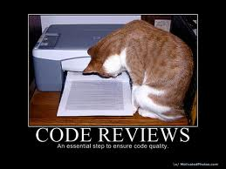
Types of Reviews
Informal review
Walkthrough
Technical Review
Inspection
Peer Review

Slide 22
Review Results
What can happen after a review?
The ideal case is that the document is okay as is or with minor changes.
Another possibility is that the document requires some changes but not a re-review.
The most costly outcome— the document requires extensive changes and a re-review. (This is less costly than ignoring the serious problems and dealing with them during component, integration, system, or acceptance testing.)

Slide 23
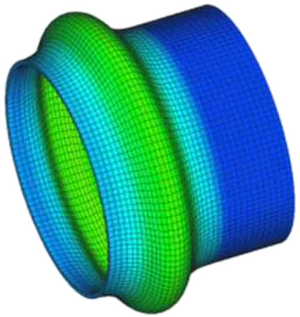
Static Analysis
Static Techniques

Slide 24
Testing Techniques Chart
Testing
Static
Dynamic
Dynamic analysis
Review
Static Analysis
Black-box
White-box
Experience-based
Defect-based
Functional
Non-functional

Slide 25

What is Static Analysis?
Analyzing software artifacts in order to gain information about the software
Source code
Binaries
Configuration files
Analyzing software “at rest”
Performed by an automated tool

Slide 26

Static Analysis Advantages
Have access to the actual instructions the software will be executing
No need to guess or interpret behavior
Full access to all of the software’s possible behaviors

Slide 27
Static Analysis Disadvantages
Require access to source code or at least binary code
Typically need access to enough software artifacts to execute a build
Typically require proficiency running software builds
Will not find issues related to operational deployment environments

Slide 28


Dynamic Techniques

Slide 29
Testing Techniques Chart
Testing
Static
Dynamic
Dynamic analysis
Review
Static Analysis
Black-box
White-box
Experience-based
Defect-based
Functional
Non-functional

Slide 30


Specification-based (Black-box) Techniques
Dynamic Techniques
Tests Blind for The Code

Slide 31
Testing Techniques Chart
Testing
Static
Dynamic
Dynamic analysis
Review
Static Analysis
Black-box
White-box
Experience-based
Defect-based
Functional
Non-functional

Slide 32
Black-box Techniques
Dynamic Techniques
Black-box techniques are a way to derive and select test conditions, test cases, or test data
Based on an analysis of the test basis documentation
Also called specification-based or behavioral techniques
Tests are based on the way the system is supposed to work

Slide 33

Blind for the Code
Black-box Techniques (2)
Black-box testing does not use any information regarding the internal structure of the component or system to be tested
The code of the tested object is not considered
Sometimes it is not accessible

Slide 34
Black-box Techniques (3)
Black-box techniques are divided into two main subtypes
Functional
What the system does?
Non functional
How the system does what it does?

Slide 35

Black-box Techniques (4)
The black-box domain includes the following techniques:
Equivalence Partitioning
Boundary Value Analysis
Decision Table Testing
State Transition Testing
Use Case Testing
Pairwise Testing
Classification Trees Testing

Slide 36
Test Bases vs. Test Oracle
The term test oracle is similar and related but not the same as the test basis
The test oracle is anything we can use to determine expected results
Which we can compare with the actual results of the component or system under test
Anything that can serve as a test basis can also be a test oracle
An oracle can also be an existing system or someone's specialized knowledge

Slide 37

Choosing Test Techniques

Slide 38
Choosing Test Techniques
Some techniques are more applicable to certain situations and test levels
Others are applicable to all test levels
Combination of test techniques
Testers usually use a combination of test techniques
Process, rule and data-driven techniques
Ensures adequate coverage of the object under test

Slide 39
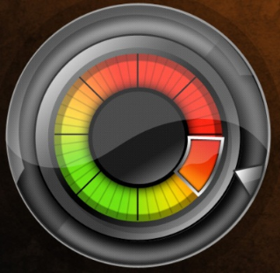
Factors for Choosing Test Techniques
The choice of test techniques to be used depends on a number of factors:
Type of the system
Regulatory standards
Customer or contractual requirements
Level of risk
Type of risk
Test objective

Slide 40

Factors for Choosing Test Techniques (2)
The choice of test techniques to be used depends on a number of factors:
Documentation available
Knowledge of the testers
Time and budget
Development lifecycle
Use case models
Previous experience with types of defects found

Slide 41
Test Design Techniques - Introduction
?
?
?
?
?
Questions?
?
?
?
?
?
?

